Slide 1



EMPLOYEE SUGGESTION PROGRAM

Slide 2
Organization of ESP Committee
Chairman: Irene Leng
Members:
Airfreight Edwin Sia
Ocean Irene Tay
Logistics K.T Chng , Melvin Tan
Finance Andrew Goh
IT Doreen Sim
Quality Robert Chew
Sales Oh Wee Nee

Slide 3
OBJECTIVE
To foster an environment
that induces and welcomes
continuous change
for greater efficiency and effectiveness
by involving our employees and
providing a formal framework
for the expression and communication
of their ideas to Management.

Slide 4
Guidelines on Suggestion
Acceptable Suggestions
Quality Improvement
Process Improvement
Service Improvement
Cost saving / Reduction
Energy Saving
Safety / Security Consciousness
Quality of Work Life
Productivity Improvement
Revenue Generation
Corporate Image Enhancement
Unacceptable Suggestions
Company Policy
Wage System
Fringe Benefit System
Complaints
Dispute/ Grievances
Criticism
Routine Authorisation For Expenditure (AFE)
Within Job Authority for Implementation

Slide 5
Evaluation
Criterion of Evaluation
Idea
      Creativity
      Originality
      Clarity
Ease of Implementation
      Procurement / Lead-time

Slide 6
Evaluation
Criterion of Evaluation…..cont’d
Quality
      Customer Satisfaction
      Reliability / Accuracy
Savings
      Cost Reduction

Slide 7
Evaluation
Criterion of Evaluation…..cont’d
Safety
      Environmental Health Safety (EHS)
Security
      Loss Prevention / Property Security
      Process Control

Slide 8
Rewards
A reward of $100 (maximum) per implementable suggestion
Annual Awards :
Best Suggestions of the Year
    Individual
    Executing or Implementing Department
Accumulated Suggestion Points Award
    Individual
    Division
Department with Highest Participation

Slide 9
Overview
For the ESP to work, the following must be in place:
    Top Management’s Commitment
    Middle Management’s Support
    Existence of Promoters
    Management’s Responsibility

Slide 10
Rules & Regulations
ESP and TQS committee members are not eligible to participate
Where identical suggestions are received, only the original
participant of the idea will be awarded
Set minimum one suggestion per employee per year
ESP-SC reserves the right to decline explanation to participants
on the outcome of all the final evaluation results of the suggestions

Slide 11
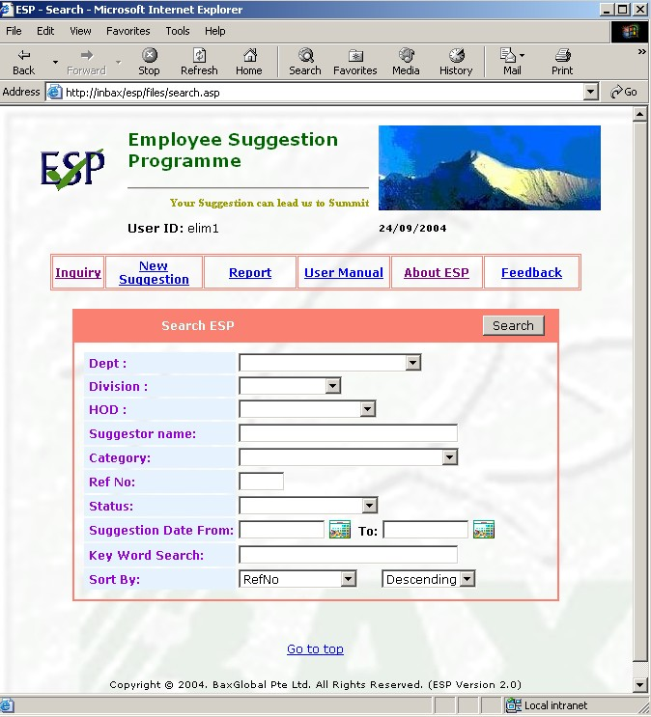
On-line ESP

Slide 12
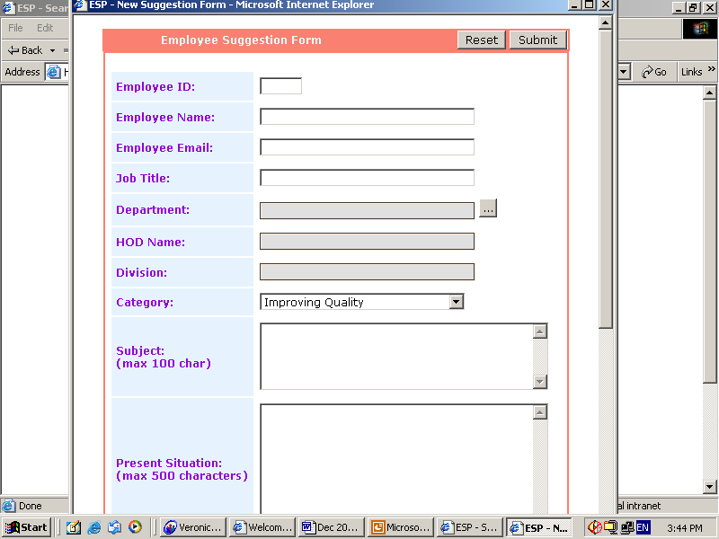
On-line ESP

Slide 13



Your suggestion will lead us to the Summit
Employee Suggestion Program

